Slide 1
Golder Rapid Response Challenge
Area 2 - Rydalmere
Team: Healthy Harold
Heejin Chang, Timothy Fong, Josh Tan, Toby Ou, Lin Luo, Ivan Xu

Slide 2
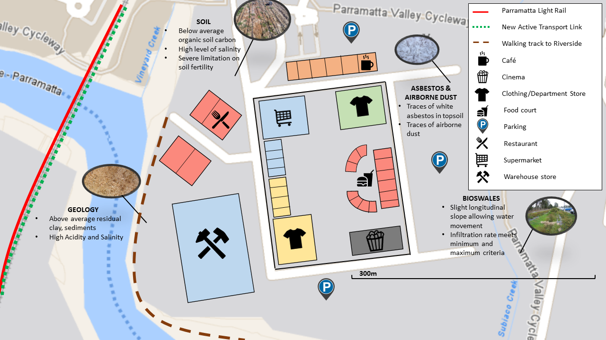
Masterplan

Slide 3
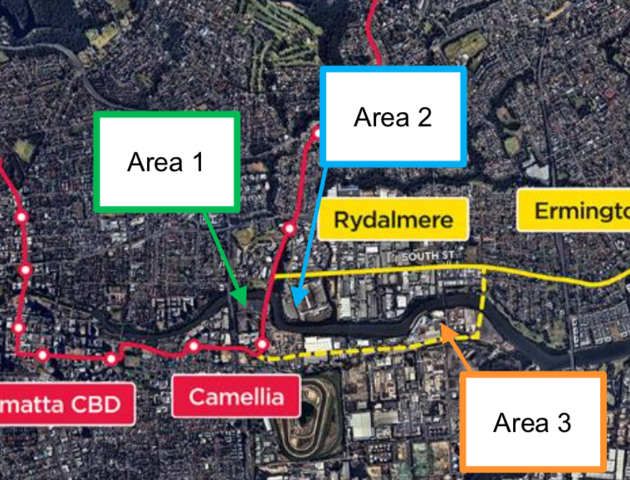
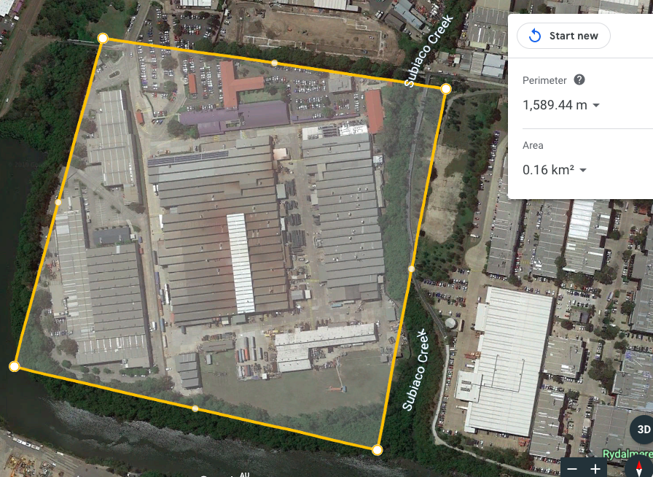
Introduction
Rheem Hot Water Systems (Industrial Site)

Slide 4
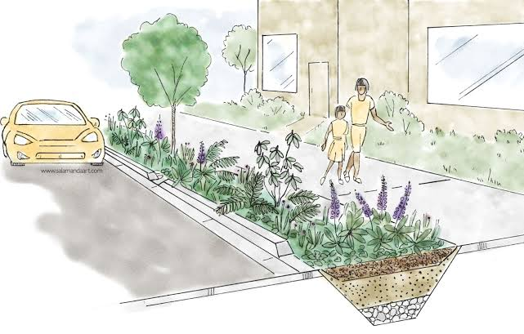
Our Strategy
Use the industrial site on Area 2 as a new shopping plaza that will host vendors (local and international)
Embed environmentally sustainable designs:
Bioswales
Temperature-reducing tree coverage
Bioswale with plants

Slide 5
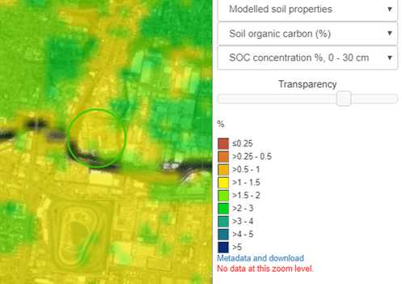
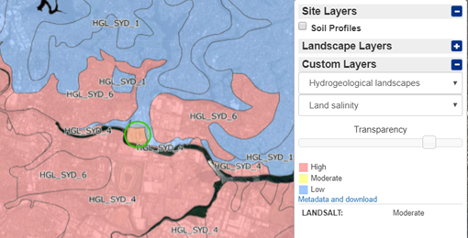
Environmental Profile

Slide 6
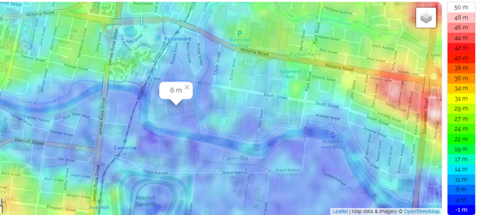
Surface Topography

Slide 7
Demography and Infrastructure
Proximity to:
Western Sydney University (Students)
Residential Areas (Tenants)
Workplaces (Workers)
New Public Transport Services:
Parramatta Light Rail
Additional Bus Services
Active Transport Link

Slide 8
Strategy Timeline
Stage 1:
Concept Design
(6 mths - 1yr)
Stage 2:
Detail Design
& Tender Process
(3-6 mths)
Stage 3:
Construction
(2-3 yrs)
Stage 4:
Landscaping
(3 mths)
Choose architects and engineers
Get concept design approved by local council for DA
Complete tender design of plaza
Onboard contractors & complete detailed design
Site establishment
Demolition
Groundworks & excavation
Build structure
Fit-out the interior
Fit-out direct from cold shell instead of providing a base fit-out to be stripped in the future → reduces waste
Construct bioswales

Slide 9






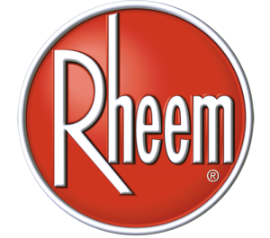
Current Infrastructure

Slide 10
Sustainable Development
Short Term Benefits
Centralised concentrated commerce (supermarkets, food stalls etc.)
Shop around on foot rather than travelling to neighbouring districts
More parking areas
Encourage people to stay within the area
Variety of activities for all ages
Efficient utilisation of space
Long Term Benefits
Reduced carbon footprints
Reduced waste production
Encourages conversion to electric heaters
Increased job availability

Slide 11
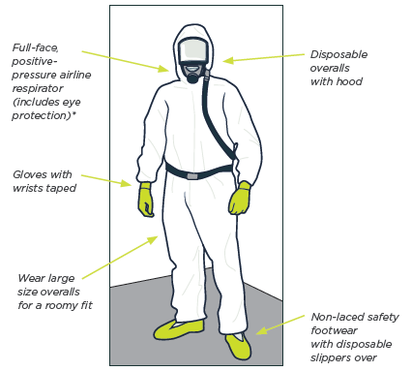
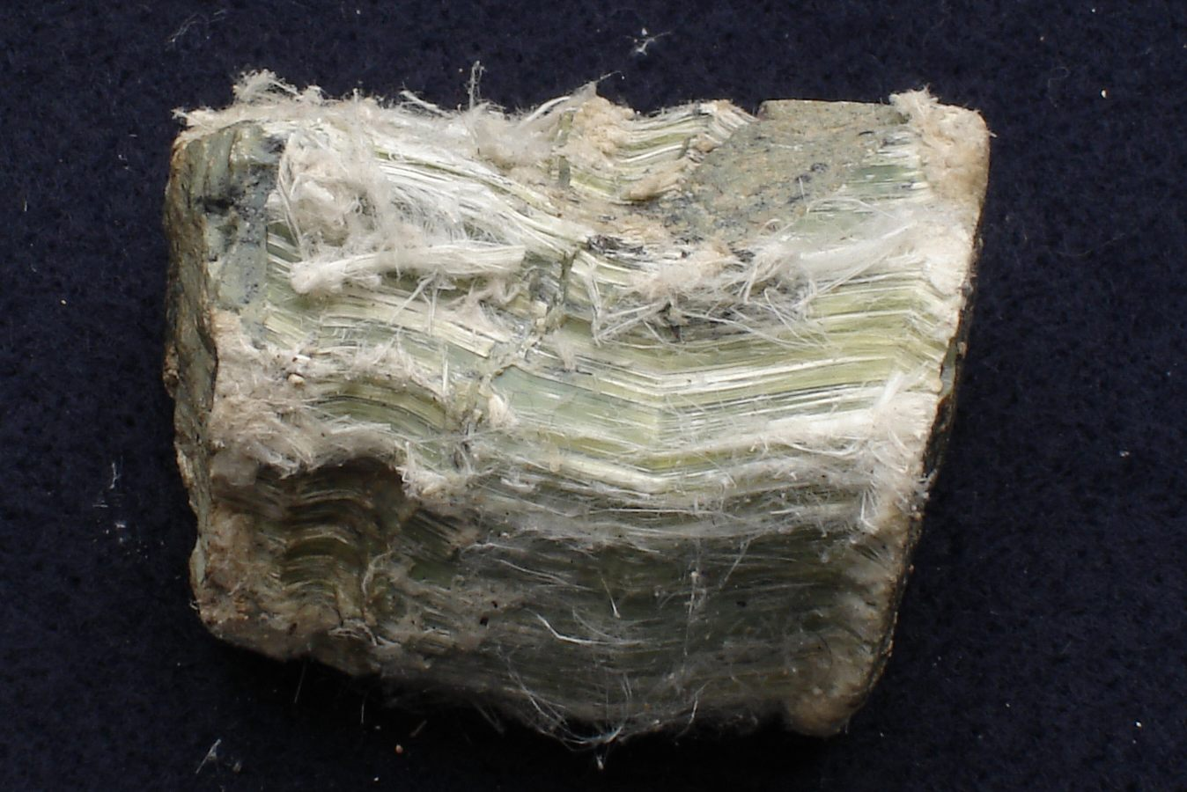
Key Risks
White Asbestos
Involved in Rheem production processes
Declared contamination free in 2017
Precautions to be taken regardless due to potential risk
Workers to be given personal protective equipment
Nearby residents and business to be notified
White Asbestos sample
Personal protective equipment

Slide 12
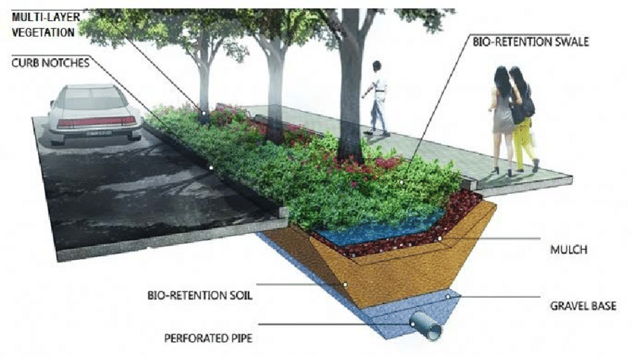
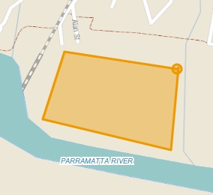
Key Risks
Contamination of Waterways
Proximity of site to bodies of water
Potential wastewater runoff would aggravate existing pollution issues in Parramatta River
Construction of bioswales throughout the site and around vicinities
Site location in relation to Parramatta River
Bioswale design

Slide 13
Conclusion & Masterplan Sketch

Slide 14
References
Benbow Environmental 2013, Asbestos, Mould, & Hazardous Materials Audit, viewed 2 November 2019, http://www.benbowenviro.com.au/assets/COMPLETE-Asbestos-Mould-Hazardous-Work-History-October-2013.pdf
Bosworth, T 2017, ‘Parramatta CBD Growing at Record Pace’, The Daily Telegraph, 8 March, viewed 2 November 2019, https://www.dailytelegraph.com.au/newslocal/parramatta/parramatta-cbd-population-growing-at-record-pace/news-story/d29be3addbad9bd5909b4df4564cf6c6
Fred Decker 2019, ‘What are advantages and disadvantages of Factories’, Bizfluent, 22 Jan, viewed 4 November 2019, https://bizfluent.com/info-8169695-advantages-disadvantages-factories.html
Home & Garden Information Center 2015, An Introduction to Bioswales, viewed 4 November 2019, https://hgic.clemson.edu/factsheet/an-introduction-to-bioswales/
NSW Environment Protection Authority 2017, List of NSW Contaminated Sites Notified to EPA as of 10 November 2017, viewed 2 November 2019, https://www.environment.nsw.gov.au/resources/clm/docs/pdf/publiclist.pdf
Parramatta River Catchment Group 2010, Parramatta River Estuary Processes Study, viewed 2 November 2019, http://parramattariver.org.au/wp-content/uploads/estuaryprocesses2010/h%20Section_8_GIS.pdf
Rheem Australia 2018, ‘Rheem upgrades Manufacturing Facility following Deregulation’, Sustainability Matters, 23 Jan, viewed 3 November 2019, https://www.sustainabilitymatters.net.au/content/water/news/rheem-upgrades-manufacturing-facility-following-deregulation-951311945

